Slide 1

at Gringotts Wizarding Bank
Diamond Theft Detection

Slide 2

As an esteemed data scientist, I was summoned to investigate a diamond theft at Gringotts Wizarding Bank. The Prime Minister introduced me to Fidelious, the Minister of Magic, and Krenk, the bank's owner.

Slide 3
Unraveling the Mystery
Given the peculiar circumstances and the lack of evidence, I delved into the extensive dataset provided by the Ministry. My task was clear: identify the stolen diamonds based on their characteristics and prices. As I scrutinized the data, two key insights emerged:
Missing Latitude Values: One diamonds in the dataset had missing latitude values, suggesting potential tampering or manipulation of data to conceal their origins. These discrepancies raised suspicion and became crucial clues in the investigation.
Outliers in Model Predictions: I trained a model to predict diamond prices based on their characteristics using machine learning techniques. Diamonds that deviated significantly from the model's predictions were flagged as potentially stolen diamonds. These outliers, with characteristics manipulated to avoid detection, provided further evidence of foul play.

Slide 4
Explanation of the magic spell EXPLORATORY DATA ANALYSIS
1
2
3
4
Data Loading
Loaded the diamond dataset using pandas, inspecting structure and data types.
Data Loading
Loaded the diamond dataset using pandas, inspecting structure and data types.
Data Loading
Loaded the diamond dataset using pandas, inspecting structure and data types.
Data Loading
Loaded the diamond dataset using pandas, inspecting structure and data types.

Slide 5




MODEL BUILDING
SPLIT DATA
Split the dataset into training and testing sets.
TRAIN MODELS
Trained machine learning models like Random Forest Regression to predict diamond prices.
EVALUATE MODEL
Evaluated models using metrics like R-squared, MAE, and RMSE.
SELECT BEST MODEL
Selected the best-performing model for further analysis.

Slide 6
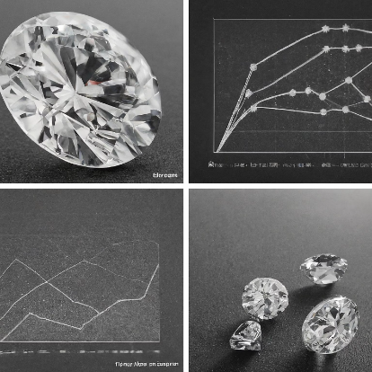
IDENTIFYING SUSPICIOUS DIAMONDS
Anomaly Detection
Applied the trained model to predict prices for diamonds with missing or anomalous data.
Calculated percentiles to establish thresholds for identifying outliers.
Visualization
Generated scatter plots and histograms to visualize characteristics and predicted prices of suspicious diamonds.
Highlighted differences between suspicious and regular diamonds.

Slide 7
UNCOVERING THE TRUTH
Missing Data
Missing latitude values indicated potential data manipulation to hide diamond origins.
Outlier Detection
Diamonds with prices deviating from model predictions were flagged as suspicious.
Visualization
Visualizations highlighted anomalies and differences between suspicious and regular diamonds.
A Possible Stolen Diamond
A diamond was found with no latitude, which suggests it could be one of the stolen

Slide 8
methodology
Data Loading
Loaded diamond dataset using pandas
Data Cleaning
Handled missing values, transformed data
EDA
Calculated statistics, visualized distributions, identified outliers
Feature Engineering
Created new features like diamond volume
Model Building
Trained models like Random Forest Regression
Model Evaluation
Used metrics like R-squared, MAE, RMSE
Anomaly Detection
Identified outliers based on predicted prices
Visualization
Visualized suspicious diamonds and anomalies

Slide 9

The saga continues
As the investigation unfolded, more mysteries emerged. The stolen diamonds were just the beginning of a larger conspiracy. With my expertise and the trust of the authorities, I was tasked with uncovering the truth behind this intricate web of deceit.

Slide 10

epilogue
As the story nears its end, I start feeling dizzy and my head starts to hurt, reminding me of the spell that will make me forget everything once I finish my task. Throughout the journey, I've faced many challenges, and now, as I come to the most important part, I feel confused and lost.
"Hmmm," I mumble, trying to remember where I left off. "I can't seem to remember. Maybe this was all just a dream. I might be a bit strange, but it was a fun story, wasn't it?"
Despite feeling unsure about what's real and what's not, I can't help but feel proud of what I've accomplished. "Well," I say with a smile, "time to get back to my normal life as a data scientist." With determination, I reach out my hand, ready to face whatever comes next.

